Slide 1
Intro to Coding with Python– Classes Pt 1
Dr. Ab Mosca (they/them)
Slides based off slides courtesy of Jordan Crouser (https://jcrouser.github.io/)

Slide 2
Plan for Today
Recap: lists and dictionaries
Activity: functions vs. methods
Creating our first class
attributes
methods
self
getting started

Slide 3
Music Library
Objective:
We want to write the code to manage a music library
The music library is made up of many songs
Each song has a title, artist, and album, and can be played
One way we could do this is by representing the library with a list and songs with dictionaries.

Slide 4
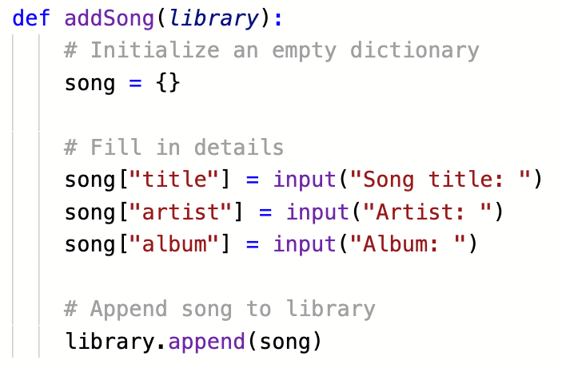
RECAP: using lists and dictionaries
What does this function do?

Slide 5
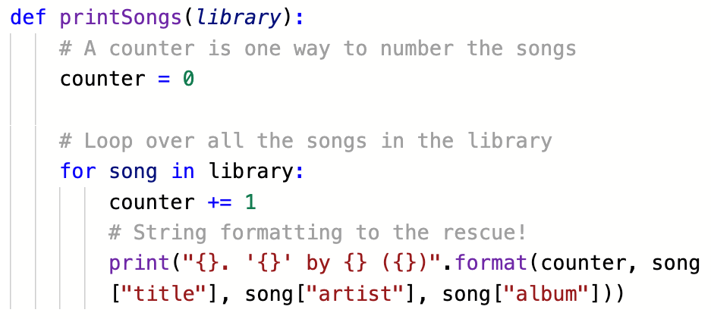
RECAP: lists and dictionaries
What does this function do?

Slide 6
RECAP: lists and dictionaries
this feels
a little funny…

Slide 7
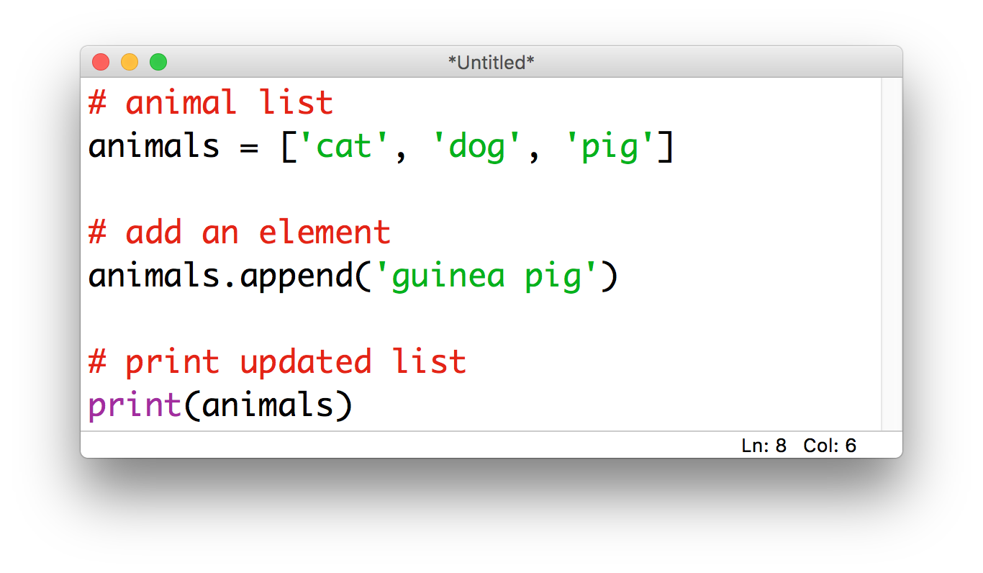
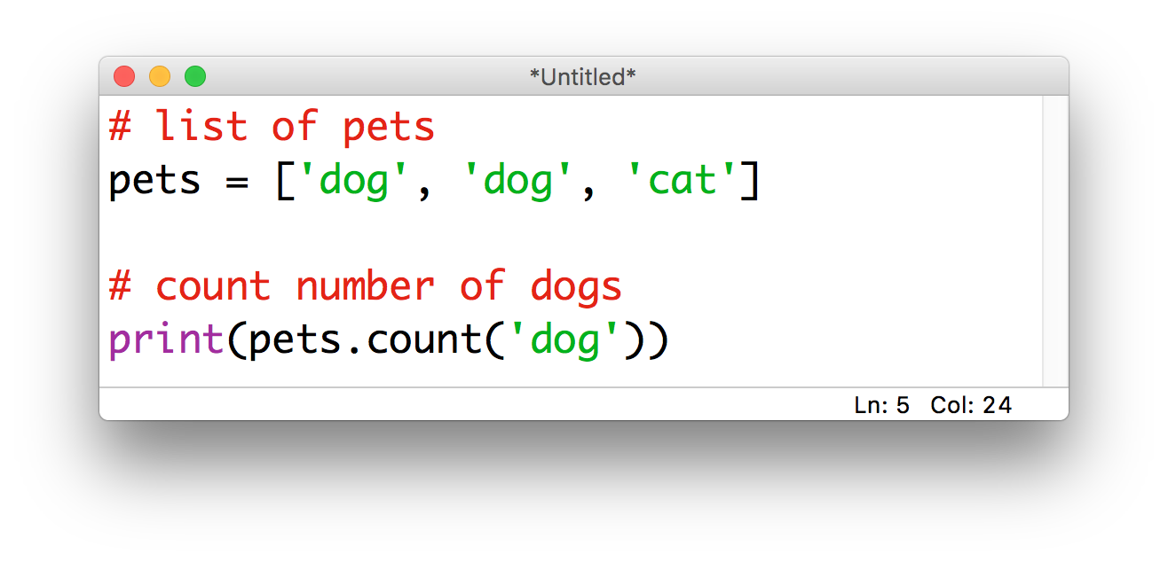
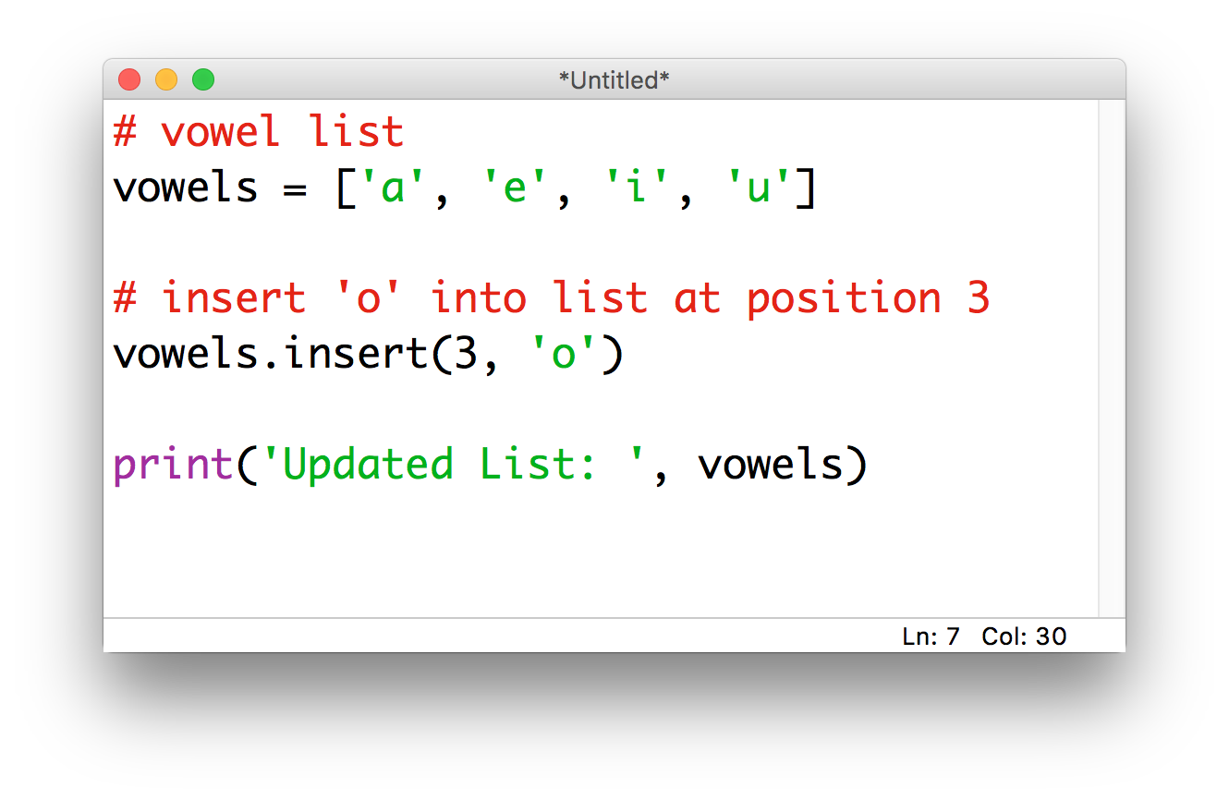
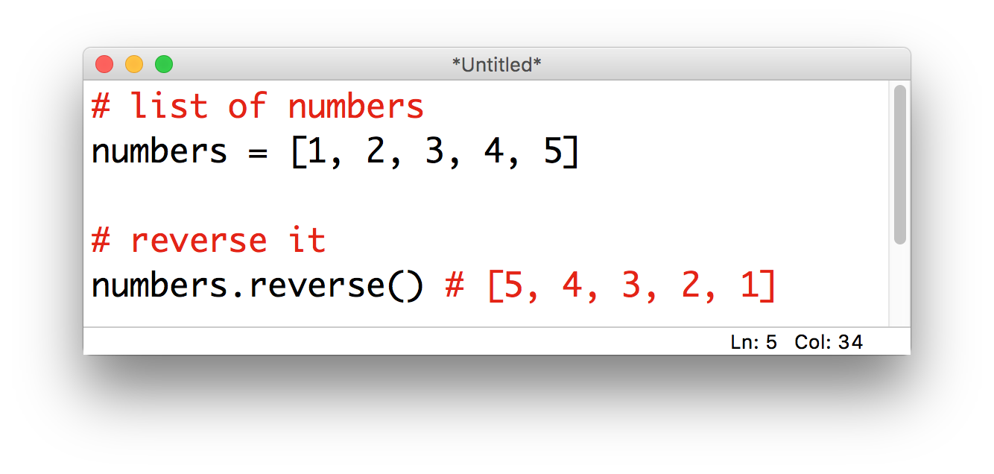
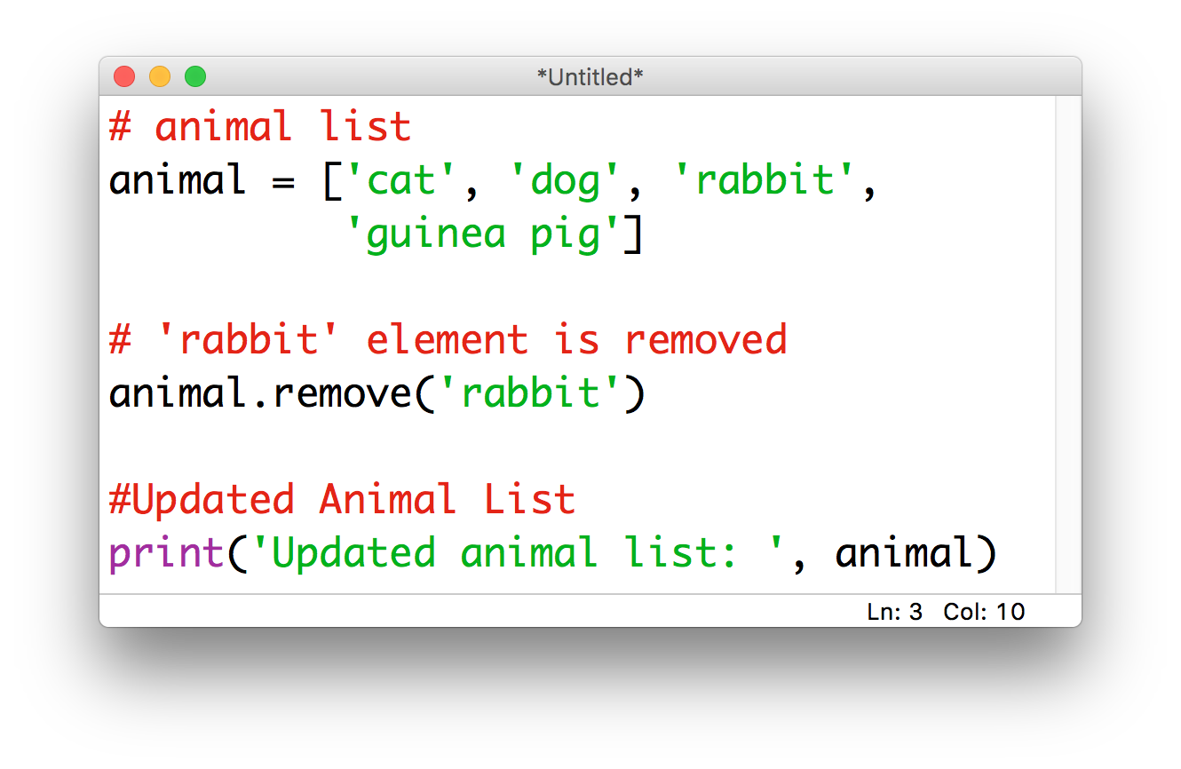
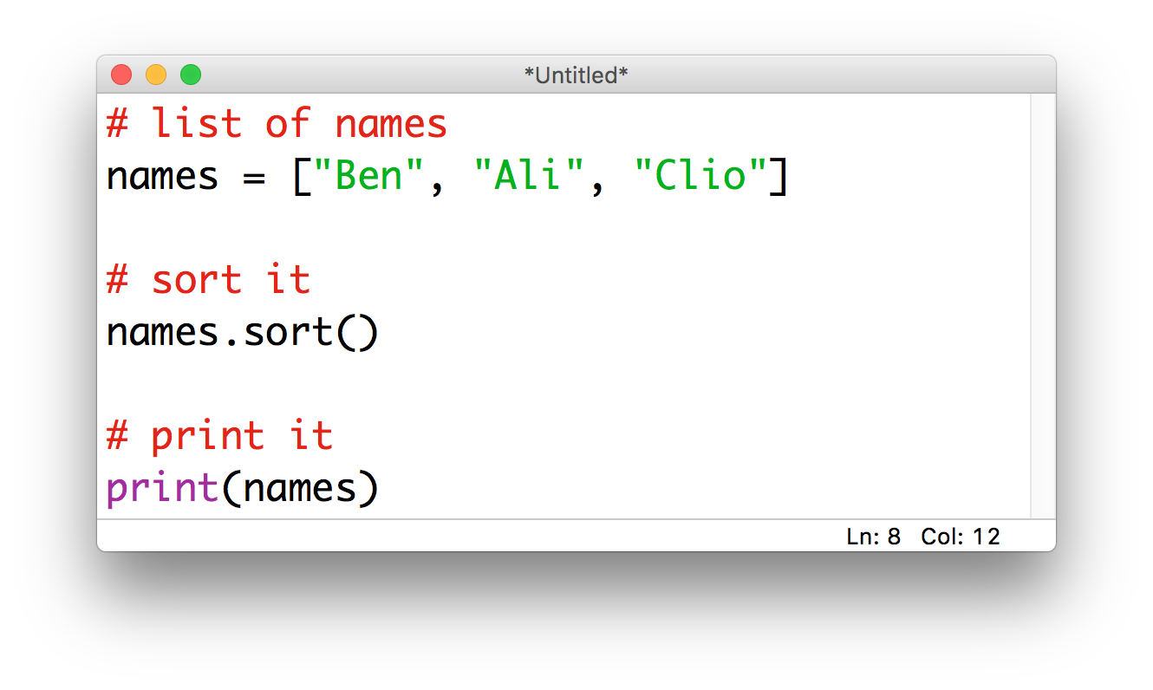
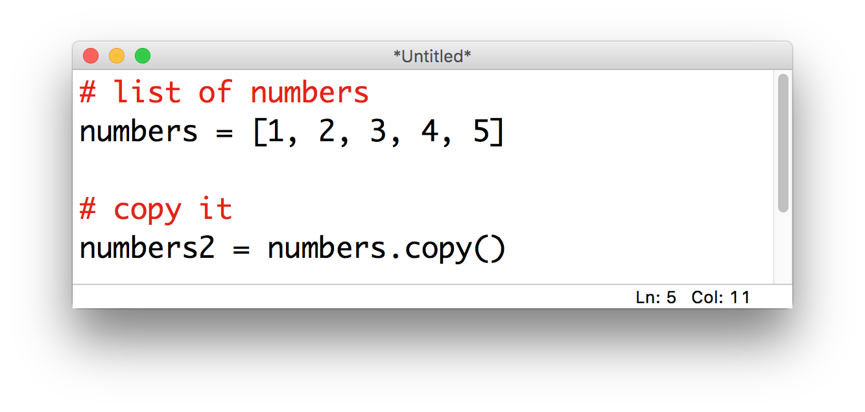
Discussion
Compare this with other operations we can perform on lists and dictionaries; what do you notice?
Notes:
Difference between function and method – these are methods, printSongs is a function

Slide 8
Discussion
So what’s the difference between
a function and a method?

Slide 9
Activity: functions vs. methods
Image courtesy: https://data-flair.training/blogs/python-method-vs-function/
Notes:
functions (in general) are things that are done BY a program TO an object
methods (in general) are things that are done BY an OBJECT TO or ABOUT itself
there are some things that “feel like” they should be methods, and others feel fine as functions
the difference is subtle, but let’s try to wrap out heads around it by thinking about it in terms of the real world
describe what someone is wearing (function)
tell me what’s in someone’s pocket (method)
make a circle around someone (function)
move someone’s chair somewhere else in the room (method)
get someone to sing the ABC’s (method)
class: put yourselves in order from tallest to shortest (could be either!)
Can you come up with other things that are probably better as methods than functions?
Are you starting to get a sense for an object’s “personal space”?
Good guideline: if it’s something an object could reasonably do for itself, it should (i.e. it should be a method, not a function)
If it changes anything about the object
Methods belong to the object, and they can access everything inside the object
When that thing needs to be done, you ask politely (i.e. call the method)

Slide 10
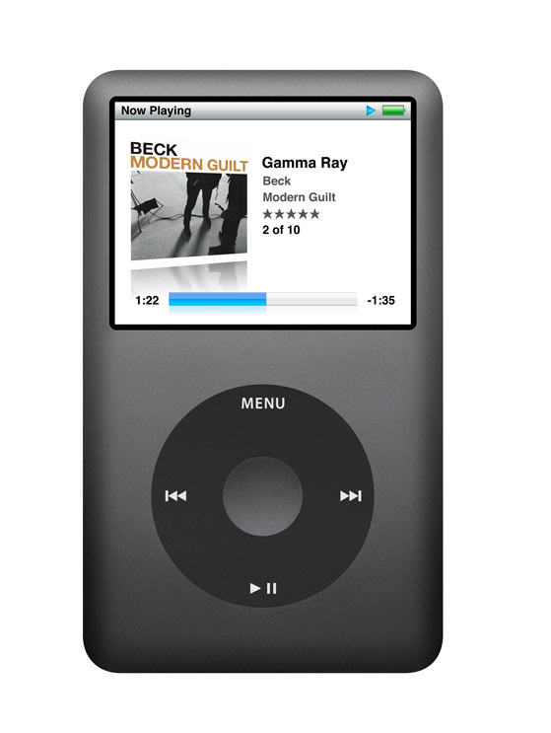
Back to the music library: what we want
We’d like to be able to ask a Song to print() or play() itself (since it already has access to all the information)
That way we don’t have to waste time passing everything from function to function
To do this, we’ll need a way to combine functions (methods) and variables (attributes)
Solution: classes
Notes:
Let’s step away from our playlist example and look at something a little simpler

Slide 11
Building a Die class

Slide 12
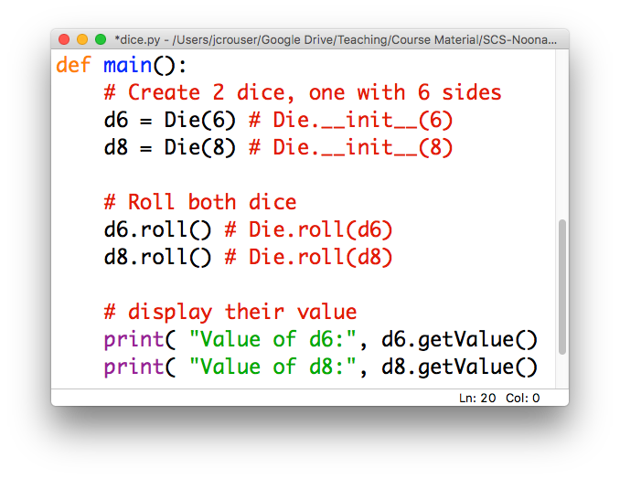
How using the class might look

Slide 13
Just one problem…
python
doesn’t know
how to do
any of this
we need to build it a blueprint

Slide 14
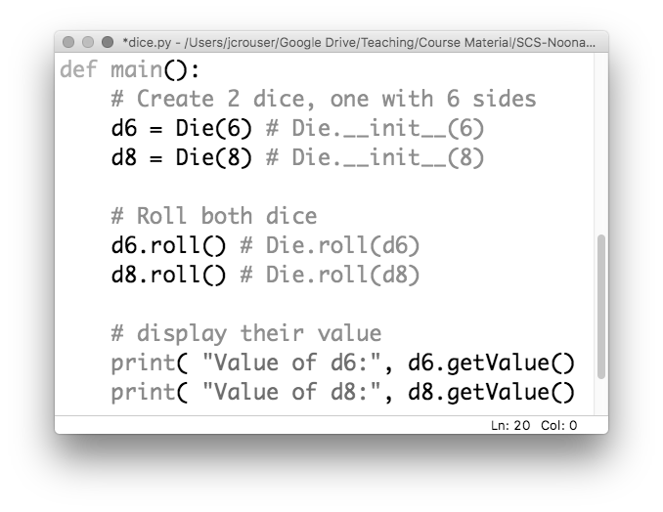
1. a way to build a Die given # sides

Slide 15
2. to be able to .roll() them

Slide 16
3. to be able to .getValue()

Slide 17
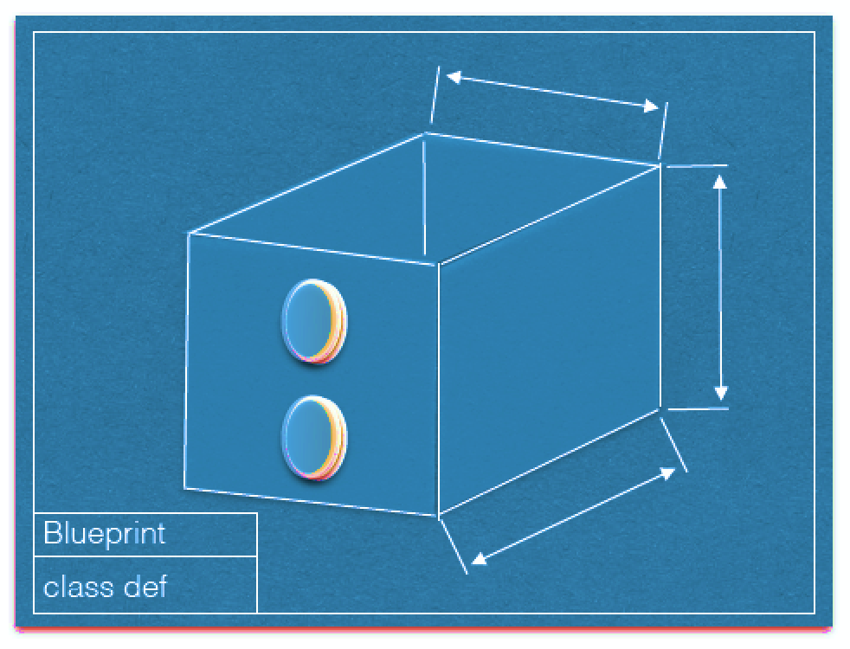
Blueprint for a Die
Image courtesy Dominique Thiebaut, Smith College

Slide 18
Blueprint for a Die: attributes
current_value
num_sides
Image courtesy Dominique Thiebaut, Smith College

Slide 19
Blueprint for a Die: methods
roll()
get_value()
Image courtesy Dominique Thiebaut, Smith College

Slide 20
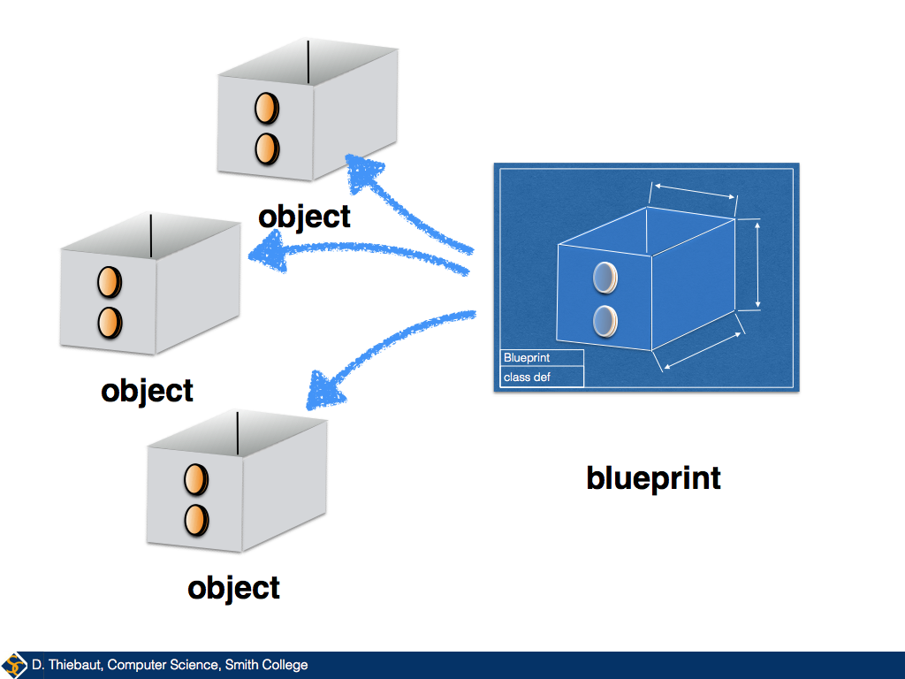
Given a blueprint, replication is easy

Slide 21
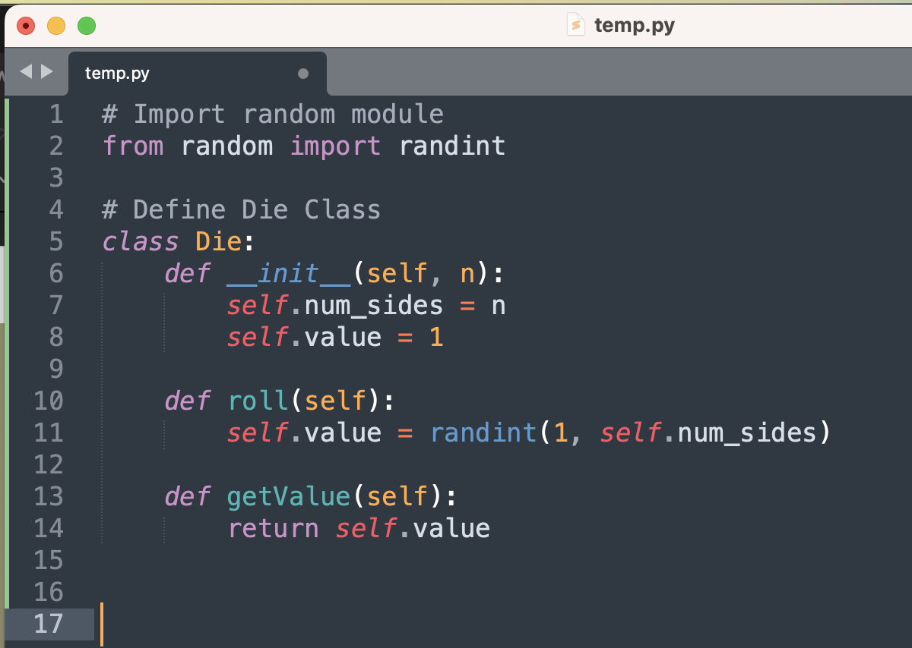
Coding the Die class

Slide 22
classes are defined using class
convention: class names start with a capital letter

Slide 23
All classes need a constructor
attribute values get initialized here
python constructors are always called __init__

Slide 24
methods are defined inside the class
nicely indented

Slide 25
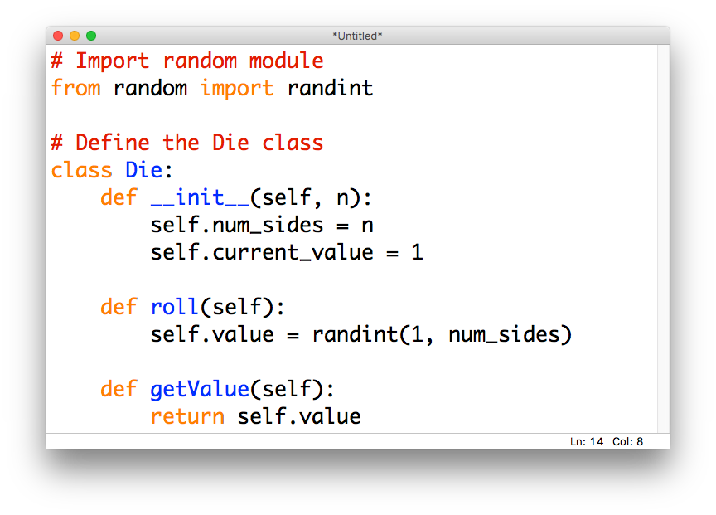
Question: what’s with all the selfs?

Slide 26
Question: what’s with all the selfs?
when attached
to a variable, self
makes the variable a
"member” of the object
(i.e. the object owns it)

Slide 27
Question: what’s with all the selfs?
every method in a class
automatically gets passed
a reference to the object
as its first parameter

Slide 28
Again, this happens automatically
we don’t put the self reference
into any of the method calls

Slide 29
But the effect is really cool

Slide 30
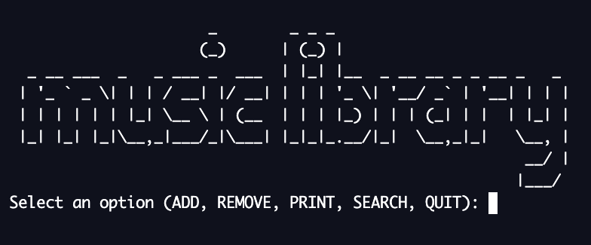
15-minute exercise: Music Library
Suppose we want to use our music library to make playlists.
Define Playlist class. Make sure it has methods to ADD, REMOVE, PRINT, and SEARCH songs

Slide 31
What did you come up with?

